Slide 1
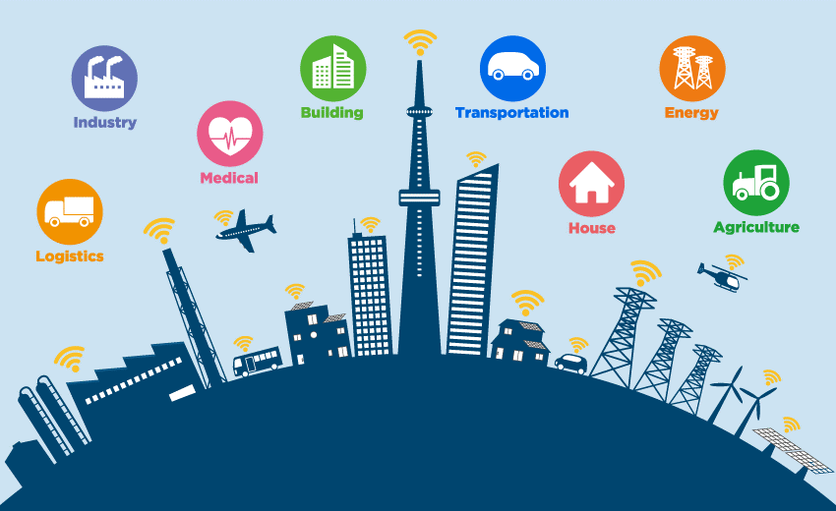
SMART CITY INFORMATION

Slide 2
Contents
Project Overview
Purpose and functionality
Use Case Diagram
User Story
UI Design
Activity Diagram
CRC Card
Class Diagram
Typical Course of events

Slide 3
Project Overview
In this software user can get to know about the necessary information of a city and also can book various kind of services like hotel, car, transportation ticket and many more. User can also take suggestion about various sector. In this system admin will verify the user and also manage the booking confirmation system. On the other hand providing the necessary suggestion and showing available booking option will be control by the system.

Slide 4
Background Study:
At present everyone wants to save time and to do so they search for things where they can get a complete package. At the same time, people at present tends to travel unfamiliar places on a regular basis and every time they spend a lot of time to find hotels and cars in different website and it is sometimes very irritating. To solve this problem, it was planned to make a website where there will be combination of various kinds of hotel booking website and online car services platform and make a single website. For example, there different hotel booking website like “Trivago,” “Agoda,” “Tripadvisor” etc. and different car renting platforms like “Uber,” “Pathao” etc. All these platforms are very well known and user friendly but the main problem is different platform provide different facility and it is hard for a user to explore all these platforms to get the best deal. From this perspective, it was planned to combine all these platforms and make a simple and single website where user will get everything in a moment.
References:
https://www.trivago.com/
https://www.agoda.com/
https://www.tripadvisor.com/
https://www.uber.com/bd/en/
https://pathao.com/bn/

Slide 5
Purpose and functionality
The project’s main purpose is to turn the city into a small place and make an apps where one can does his/her every activities like searching for hospital, tourists place or even booking a guide/ticket for travel and many more.
Some of the basic functionalities are:
* Provide proper information about the city.
* Rating system to provide the best option for user.
* Renting car.
* Provide guide for travelling.
* Booking tickets of transportation.
* Suggest best offer considering the user type.

Slide 6
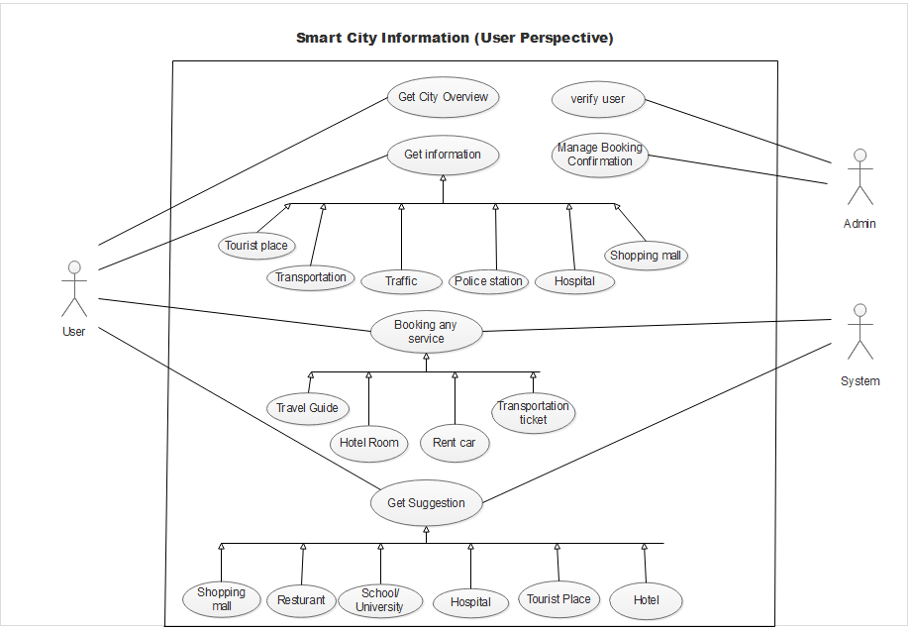
Use Case Diagram

Slide 7
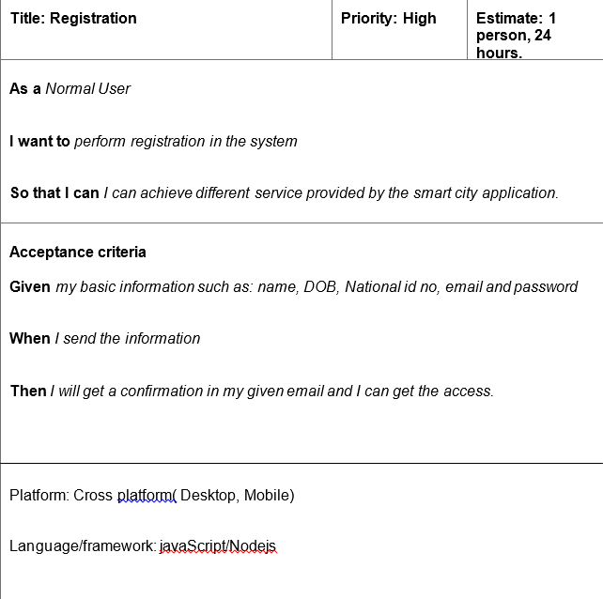
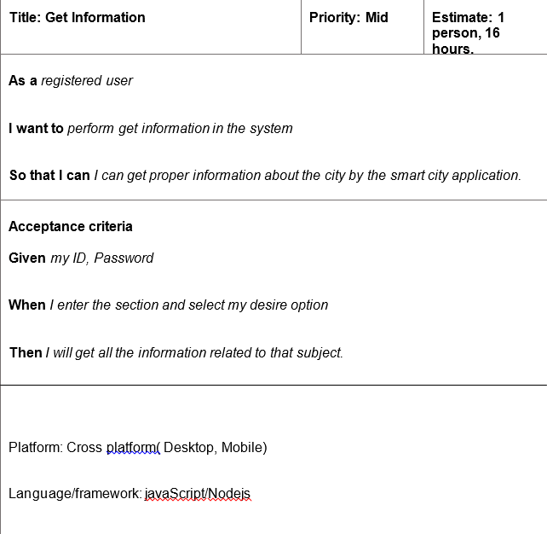
User Story

Slide 8
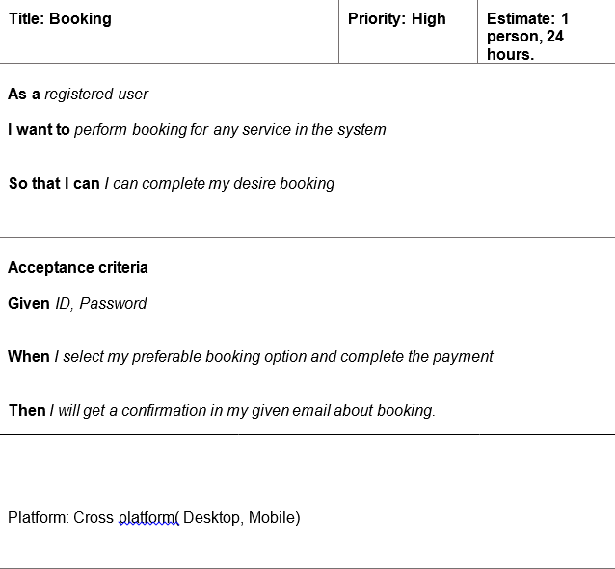
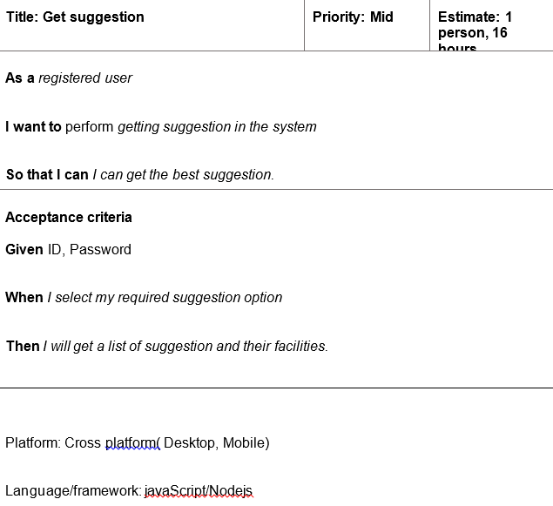
User Story
Class Work on Graph description

Slide 9
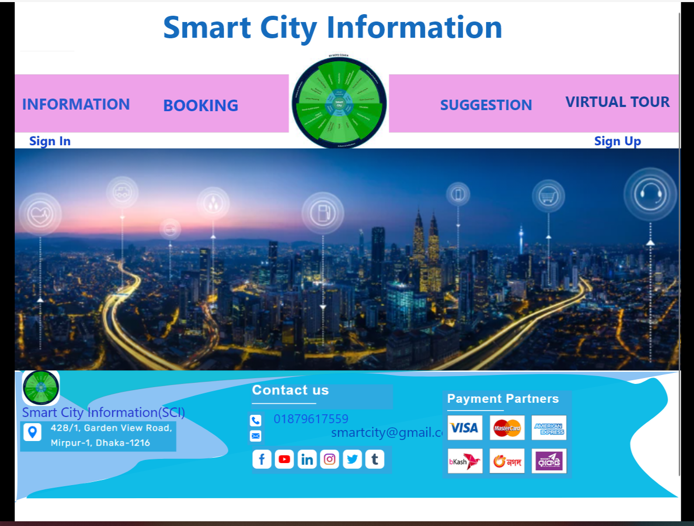
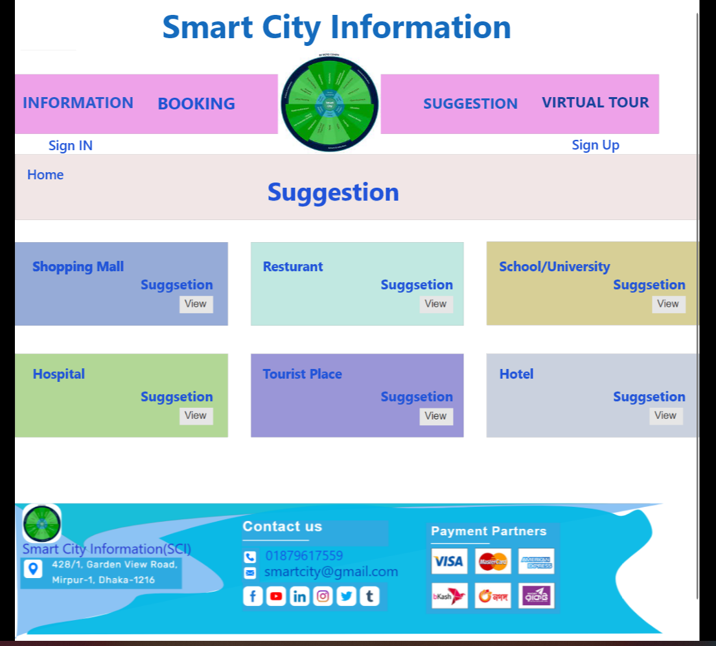
UI Design

Slide 10
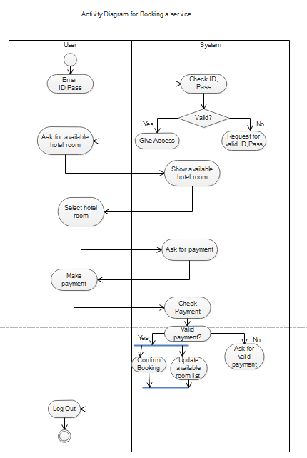
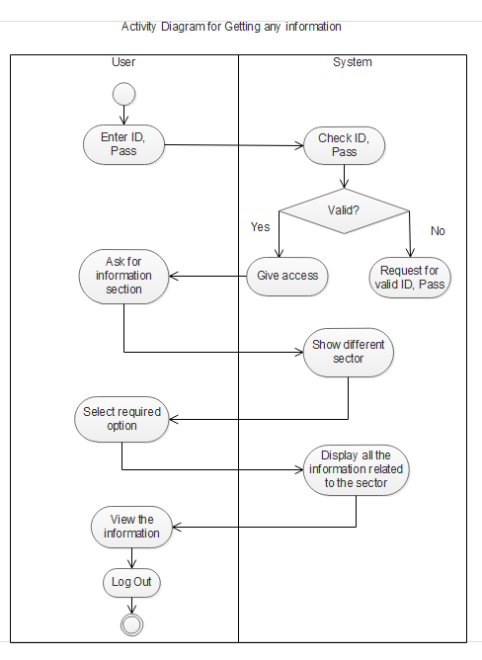
Activity Diagram
Activity Diagram for Booking a service
Activity Diagram for getting any information

Slide 11
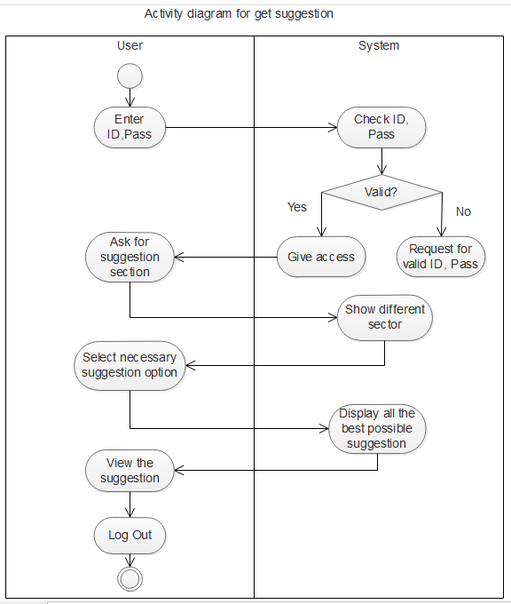
Activity Diagram
Activity Diagram for Get Suggestion

Slide 12
CRC Card
Class name: User
Sub Class:
Super Class:
Responsibilities | Collaborators
Sign up, Sign in | 1. Customer 1
2 Get information | 2. Customer 2, etc.
3 Booking any services
4 Get suggestion
Class name: Admin
Sub Class:
Super Class:
Responsibilities | Collaborators
Verify user | 1. Booking admin
2 Manage booking confirmation | 2. Verification admin

Slide 13
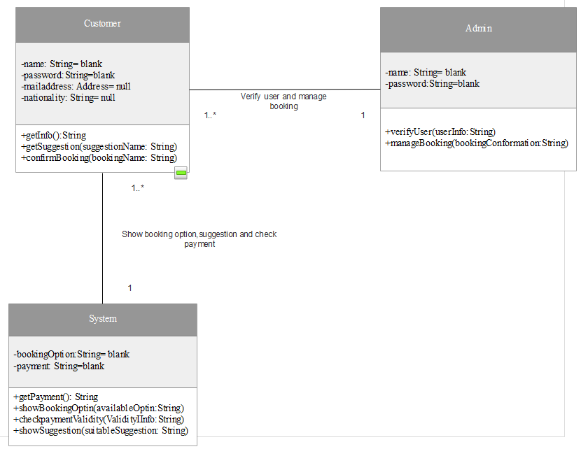
Class Diagram

Slide 14
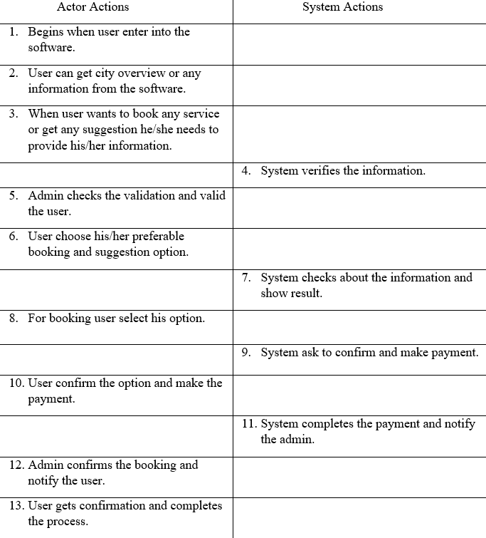
Typical Course of events

Slide 15
Alternative flow of events
Step 4: If system found that the information is not valid it notify the user and ask for valid information.
Step 7: If system found that the chosen option is not available, it notify the user and ask for another option.
Step 11: If system found that user doesn’t make the proper payment, it ask the user for proper payment.
Exceptional flow of events:
Because of any failure in the system the confirmation system may not complete and user have to login again for the confirmation.

Slide 16
Impact of this Project:
Through this project, it was possible to help the users to save their valuable time and provide the best possible offer in a single place and users were able to check if they were getting actual prices and discounts or not. It also prohibited the hotel and car owners from charging extra money from the user.
In this application, it was tried to promote electric cars and CNG-driven cars so that there was a clean and safe environment for the future generation.

Slide 17
Limitations and Possible Future Improvements
Limitations:
* No mobile or desktop application
* Limited feature
* Only data of a few cities are available
Potential future improvements:
* Addition of new features like online ticket booking, food delivery system etc.
* Google map can be used to track locations.
* More user-friendly UI.

Slide 18
THANK YOU

